Slide 1
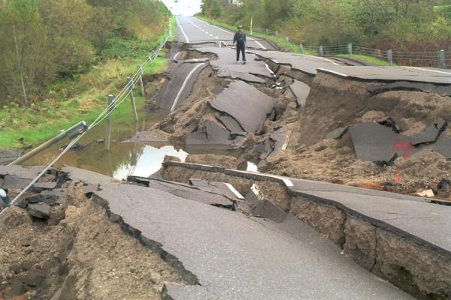
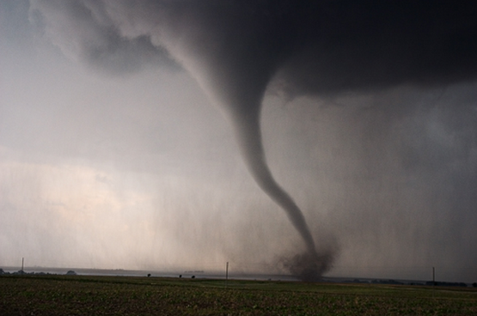
Natural Disasters
Earthquakes and Tornados
Morgan Spillman
Vanessa Sanders
Period 9

Slide 2
The Dangers of an Earthquake
When an earthquake occurs it shakes the ground violently. Buildings, bridges and other large structures can collapse. Floods can occur from the walls of dams breaking. Rock slides/Landslides are another thing that would happen. Tsunamis can occur and destroy houses and towns. All of these things can hurt many people when an earthquake occurs.

Slide 3
Preparation for an earthquake
If you evacuate during an earthquake you may need:
Food and water
First Aid Kit
Portable Radio
Flashlight(extra batteries)
Blankets
Shoes and Clothes
Money

Slide 4
Protection During an Earthquake
DROP down on your hands and knees
COVER your head and neck
HOLD ON to your shelter

Slide 5
Dangers of Tornados
Tornadoes develop from severe thunderstorms. They are usually preceded by very heavy rain and/or large hail. A thunderstorm accompanied by hail indicates that the storm has large amounts of energy and may be severe. In general, the larger the hailstones, the more potential there is for damaging winds and/or tornadoes.The most violent tornadoes are capable of tremendous destruction with wind speeds of 250 mph or more. Damage paths have exceeded the width of one mile and 50 miles long. Tornadoes generally move from southwest to northeast, but have also been recorded traveling in any direction. The forward speed of a tornado varies from 30 mph to 70 mph.

Slide 6
What you should do during a tornado.
D - Go DOWN to the lowest level
U - Get UNDER something
C - COVER your head
K - KEEP in shelter until the storm has passed
Take responsibility for your safety and be prepared before a watch or warning is issued. Meet with household members to develop a disaster plan to respond to tornado watches and warnings. Conduct regular tornado drills. When a tornado watch is issued, review your plan – don't wait for the watch to become a warning. Learn how to turn off the water, gas and electricity at the main switches

Slide 7
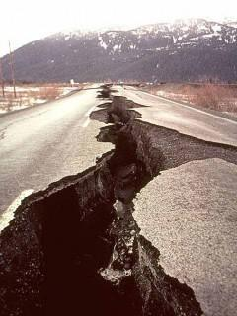
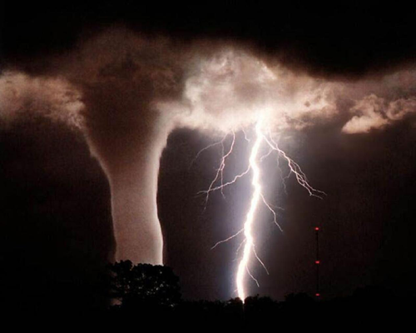

Slide 8
Tornado video
http://www.dailymail.co.uk/news/article-2749114/Inside-heart-tornado-Driver-captures-terrifying-moment-car-engulfed-freak-weather-Russia.html#v-3774905944001

Slide 9
Earthquake Video
http://video.nationalgeographic.com/video/weather?source=relatedvideo

