Slide 1
Fire Safety
by: Taylor Bridgeman & Matthew Troyer
P-5

Slide 2
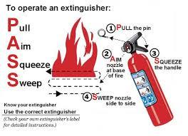
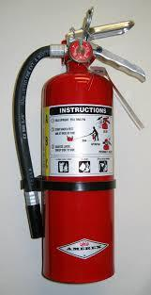
How to avoid fire
Don’t play with matches, lighters and the oven or stove.
Know how to exit your home safely and your meeting place.
Know where your fire extinguishers are and know how to use them properly.
Check smoke alarms yearly.

Slide 3
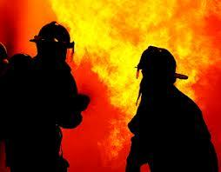
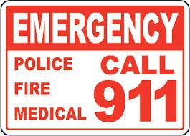
What to do if there is a fire
Get out of the house, using one of your exit routes.
Then call 911.
DO NOT go back in a burning building for possessions. Items can be replaced but lives can’t.
Wait for family to find you at your meeting place.
If home alone, go to neighbors or safe spot.

Slide 4
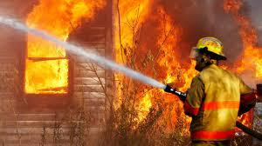
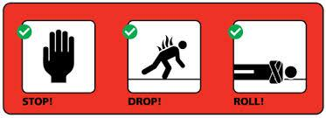
What to do if in a burning building
Crawl below smoke.
DO NOT open doors the handles attract heat.
If on fire, stop, drop and roll.
Try to get out as fast as you can.

Slide 5
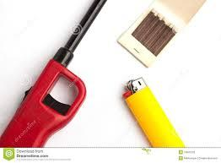
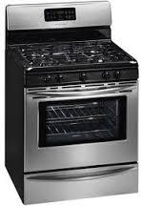
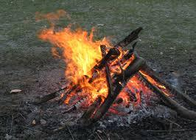
What can cause a fire
Matches
Lighters
Campfires
Stoves/Ovens
Burners

Slide 6
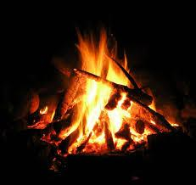
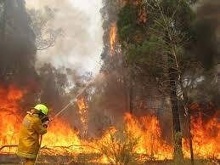
Outdoor fires
If in the woods having a campfire, you should be mindful of your fire and always watch the fire
If catch something on fire, roll it in the dirt to put it out
Fire can cause wildfires and destroy wildlife
Keep flammable items away from fire
If camping in a camper, always have a fire extinguisher
Make sure the fire is safely put our before leaving it unattended

