Slide 1
Outside Safety
By: Adrianna Spring & Kennedy Allen

Slide 2
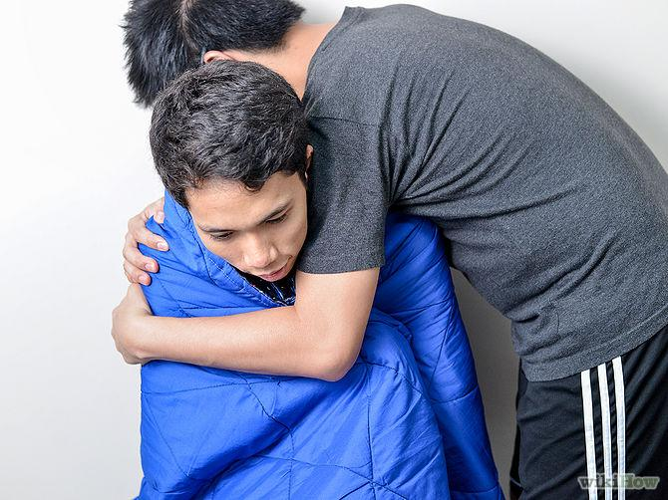
Hypothermia
Signs & Symptoms
Shivering
Slurred speech or mumbling
Low energy or drowsiness
Treatment
Remove wet clothing
Place warm objects next to the head, neck, chest, and groin to increase body temperature
Take them to get medical attention
Prevention
Wear proper clothing
Stay hydrated
Be familiar with signs of hypothermia

Slide 3
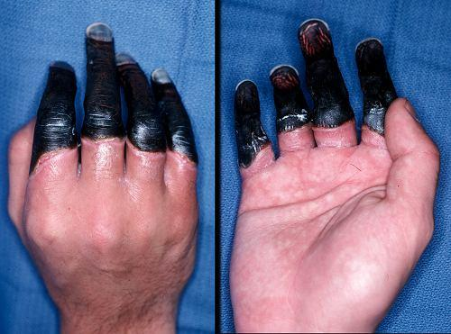
Frost Bite
A few Signs & Symptoms
numbness
red, white, bluish-white, or grayish-yellow skin
hard or waxy-looking skin
Treatment
get out of cold and get out of wet clothes as soon as possible then immerse the affected area in WARM water
Prevention
Don’t drink alcohol before or during cold weather exposure
Don’t smoke, it constricts blood vessels and increases the risk for frostbite.
Wear several layers of clothes

Slide 4
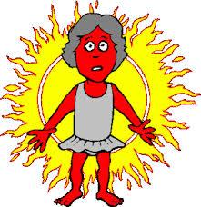
Heat Stroke
Signs & Symptoms
throbbing headache
dizziness and lightheadedness
red, hot, and dry skin
Treatment
lower the person's body temperature (get them out of the heat)
rehydrate (give cool, non alcoholic and non caffeinated beverages as long as the person is alert)
rest (avoid physical activity for the rest of the day)
see a health care provider (only if symptoms gets worse or last more than an hour
Prevention
wear loose fitting, lightweight clothes
protect your skin against sunburn
drink plenty of fluids

Slide 5
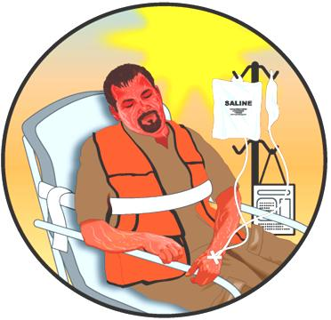
Heat Exhaustion
Signs & Symptoms
Confusion
Dark urine
Fainting
Treatment
Take cool showers
Drink non-caffeinated and alcoholic fluids
Remove tight clothing
Apply other cool objects such as fans or ice
Prevention
Stay hydrated
Avoid hot spots
Wear loose fitting clothes

Slide 6
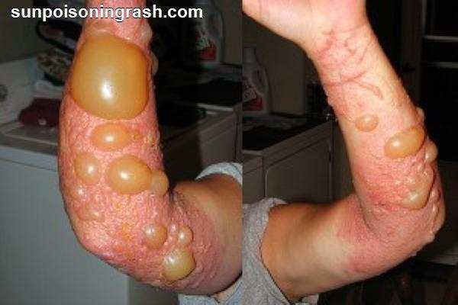
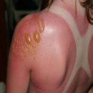
Sun Poisoning
Signs & Symptoms
skin redness
swelling
pain and tingling
Treatment
get out of the sun
use aloe gel or moisturizer
drink extra fluids for a few days
Prevention
wear sunscreen (spf at least 30)
limit your sun exposure between 10 am and 2 pm
wear a hat, sunglasses, and protective clothing

